Slide 1
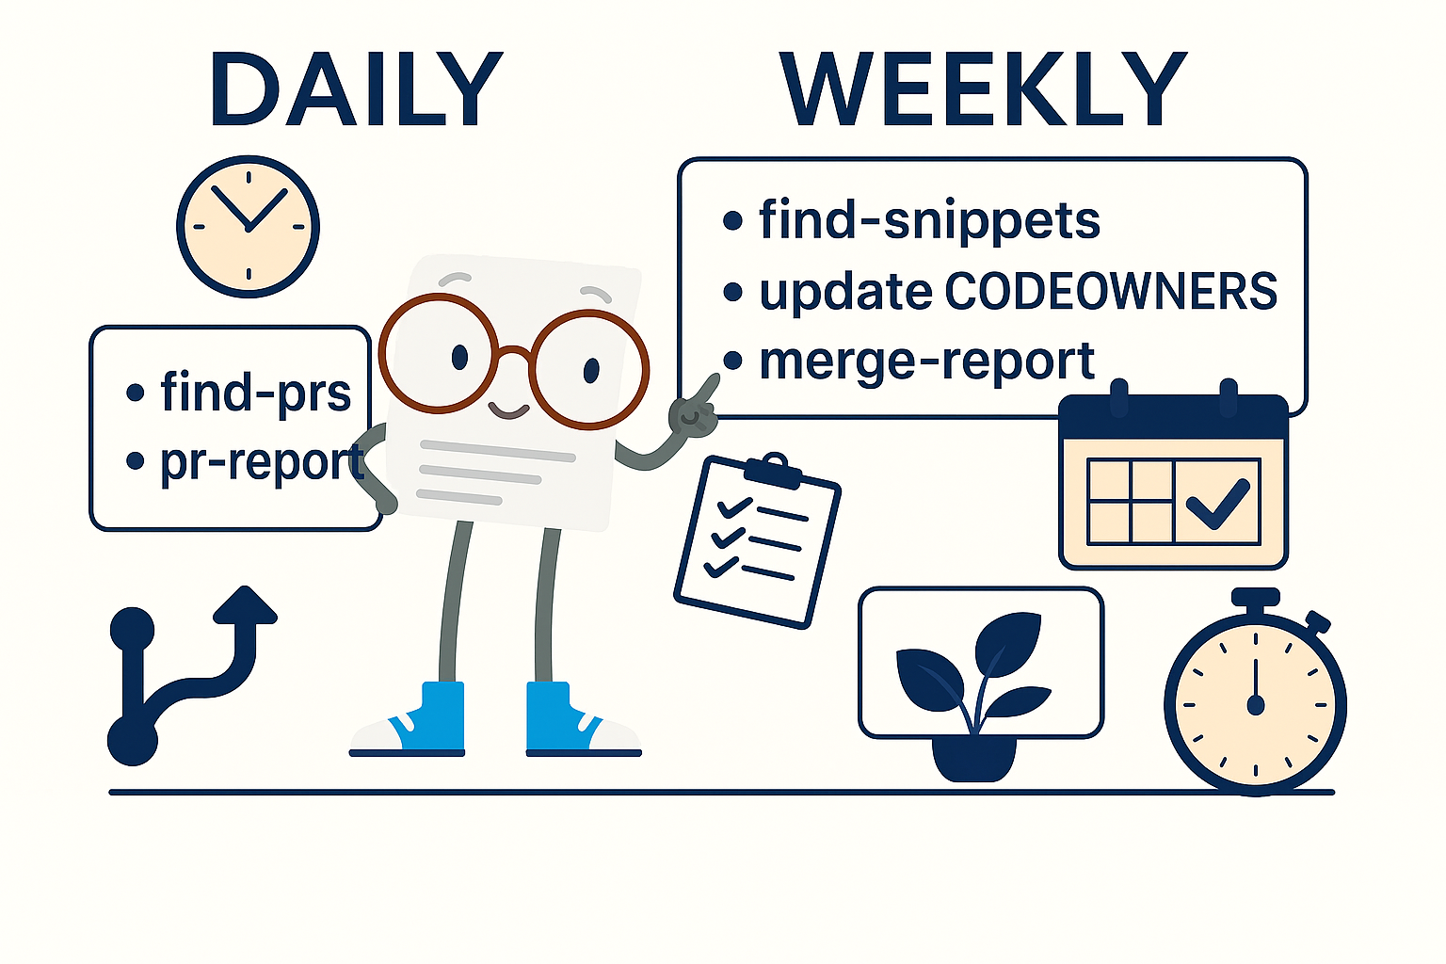
Code Snippet Maintenance in Documentation
Machine Learning Studio
Azure AI Foundry
Notes:
Welcome. This short video introduces the workflow for code snippet maintenance in documentation, specifically what we do for Azure Machine Learning and Azure AI Foundry.

Slide 2
Definitions
Code Repo Public GitHub repositories where sample code is stored
(foundry-samples)
Docs Repo The MicrosoftDocs repository where documentation articles are stored
(azure-ai-docs-pr)
Maintenance Repo GitHub repository where the code maintenance process scripts are stored
(sdgilley/code-maintenance)
Notes:
First a few definitions. There are three different types of repositories involved in this process. To try to keep them straight, we’ll call them the Code Repo (where the sample code is stored), the Docs Repo (where the markdown articles are stored), and the Maintenance Repo (where the scripts for the maintenance workflow are stored).

Slide 3
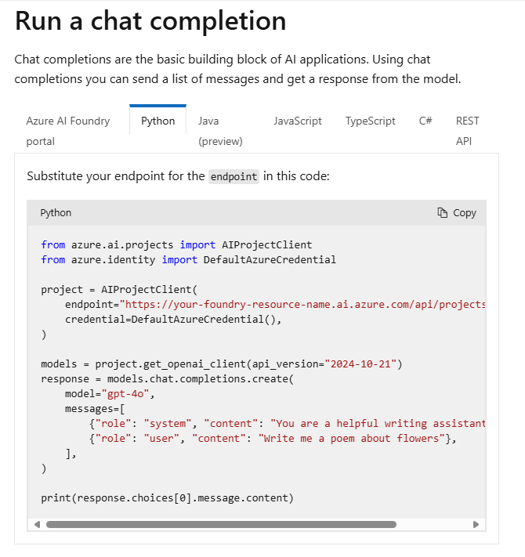
Learn site
Notes:
Now a quick overview of what we’re doing.
Here’s an example article on the learn site, which contains some code.

Slide 4
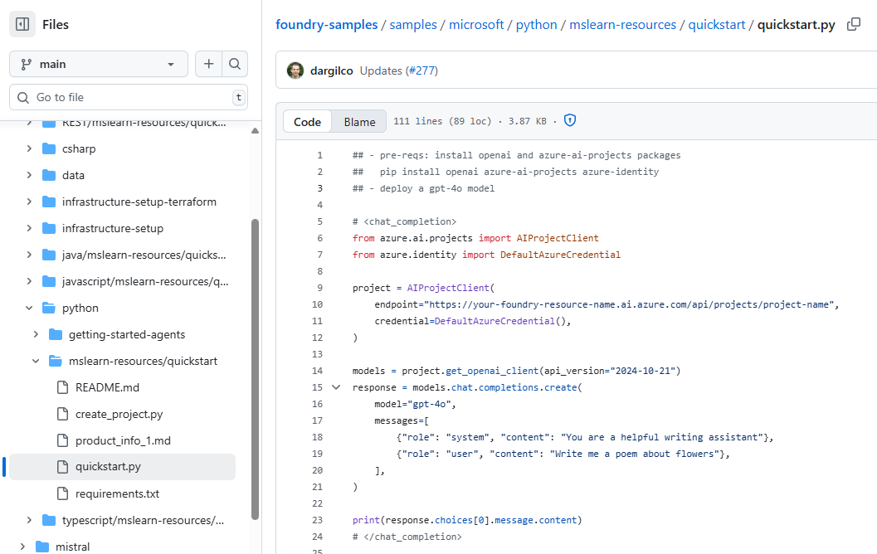
GitHub
# <chat_completion>
# </chat_completion>
Notes:
Here’s the actual code content, stored in a Code Repo. Note the comments that start and stop the block of code called chat_completion.

Slide 5
How to reference
azure-ai-docs:
.openpublishing.publish.config.json: { "path_to_root": "foundry-samples-main",
"url": "https://github.com/azure-ai-foundry/foundry-samples",
"branch": "main",
"branch_mapping": {}
},
Notes:
In order to use code from a external Code Repo, first you need to set a pathToRoot entry in the config file. I always use the repo name, followed by -<branch name>.

Slide 6
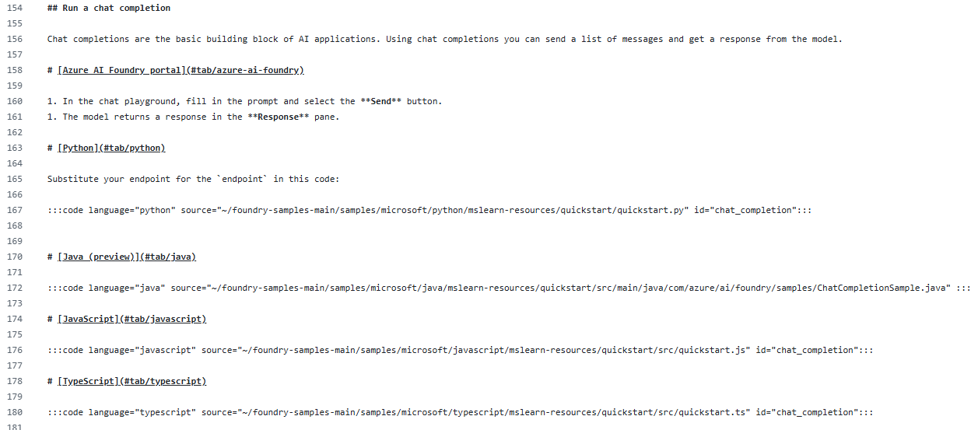
Article markdown
:::code language="python" source="~/foundry-samples-main/samples/microsoft/python/mslearn-resources/quickstart/quickstart.py" id="chat_completion":::
Notes:
Now that you have a pathToRoot, use it to reference the file. Use id to get to the particular block you want to display.

Slide 7
Advantages
Code authored in a code editor
Code styles enforced by PR process in the code repo
Code repo maintained by teams using the code
Public GH repo and docs have single source of truth
Code repo can be set up with automated testing
Code is runnable
Notes:
What are the advantages of this approach? There are quite a few.
The code is authored in an editor that can show typos or mistakes.
It’s runnable.
When checking it in to the Code Repo, consistent styling can be enforced.
In our case, the code repo is maintained by teams that are using the code.
The Code Repo can be set up with automated testing
And finally, there is a single source of truth for the code to demonstrate an idea.

Slide 8
PROBLEMS
File deletion - Referenced files are removed
File renaming - Referenced file paths change
Content changes - Named sections or code blocks are modified or removed
Code file updates not reflected in docs until referring article is rebuilt
Notes:
But it comes with a cost.
It’s fairly easy for someone creating a PR in the Code Repo that would break our build.
If the PR deletes or changes the name of the file we reference; or removes the comments that start or stop a block of code, Our Docs build breaks
Finally, while the last problem doesn’t break anything, it is still an issue. When a code file is updated, the doc referencing it won’t be updated until it is rebuilt.

Slide 9
SOLUTION: Monitor the Code Repo
Use CODEOWNERS to protect files we reference
Any change of these files require our review
Notes:
The solution to these problems is to monitor the code repo. That’s the whole point of our code snippet maintenance process.
In the Code Repo, we add a CODEOWNERS file that lists all the files we reference.
The Code Repo is also set up to require a review from a codeowner before merging. This allows us to review and head off any of those problem PRs before they happen.

Slide 10
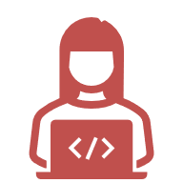
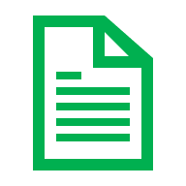


Maintenance Process
Daily
Monitor pull requests in code repositories
Weekly
Update CODEOWNERS files
Update docs to rebuild
Update maintenance repo files
See github.com/sdgilley/content-maintenance
Notes:
Our process consists of both Daily and Weekly tasks. The process involves a series of Python Scripts, stored in the Maintenance Repo.
All the scripts can be run in a Codespace from the maintenance repo.
The process does involve creating PRs in all three of the different types of repos: the Code repo, Docs repo, and Maintenance repo. We’ll dive into these next.
We assign a different person to do these tasks each month for the Machine Learning & Foundry content.

Slide 11

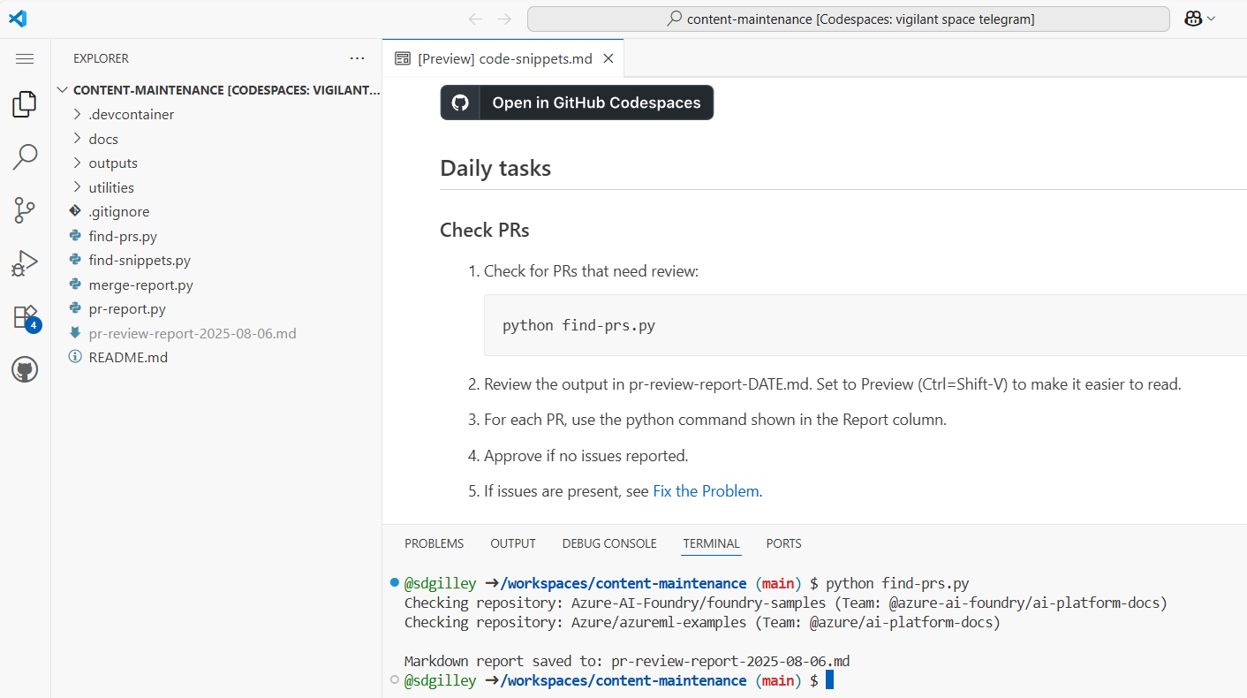
Daily: monitor PRs
CODESPACE
Notes:
Daily, we check to see if there are PRs in the code repo that require review.
Since we now actually have code scattered across multiple Code Repos, we have a script that looks through them all.
The output from the script is a markdown file containing the report.

Slide 12
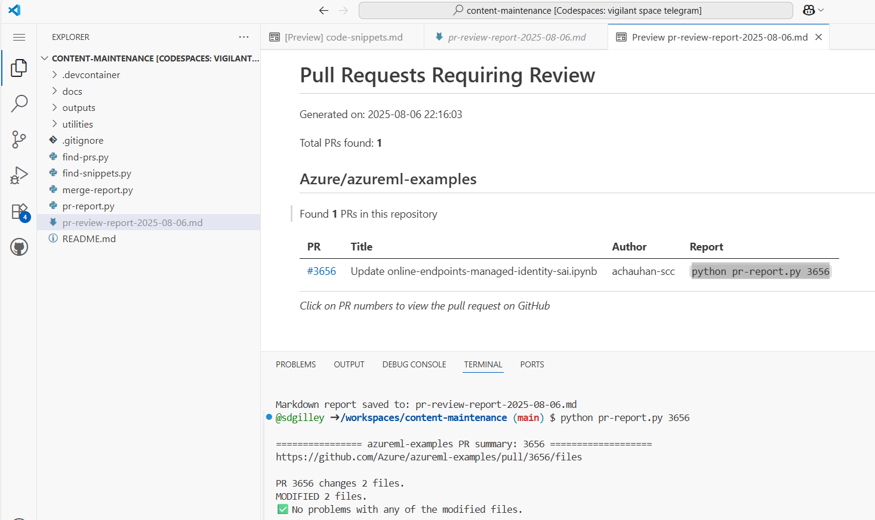
Review PR
CODESPACE
Notes:
Once find-prs runs, open the markdown file and view the table.
There’s a link to each PR to go approve it.
But first, for each PR, there’s a script that tells us if there are any problems in the PR. In this case, there were 2 files modified, but no problems with them.

Slide 13
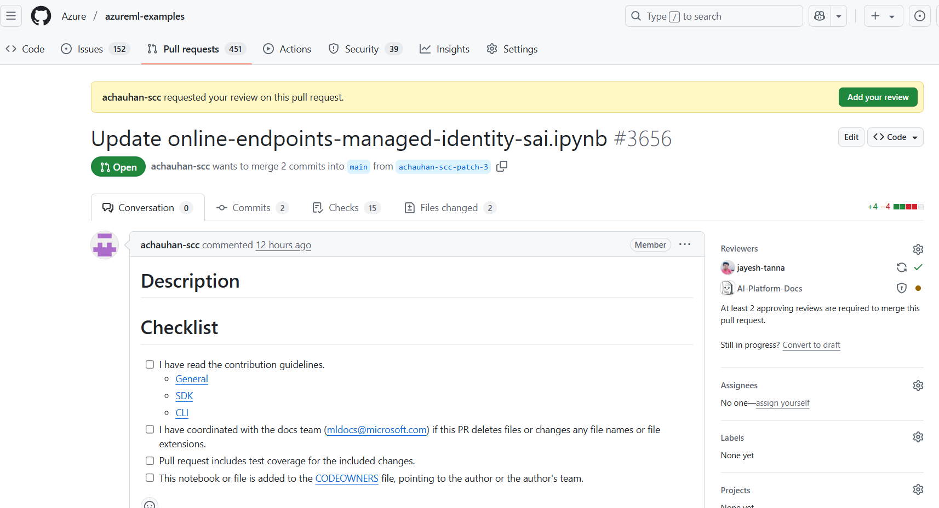
Approve PR (Code Repo)
Notes:
We can go approve this PR in the code repo. Notice that AI-Platform-Docs is a required reviewer. That’s our GitHub team name, so that anyone in that team can approve.
That’s all there is for daily tasks.

Slide 14

..or Fix the Problem first (Docs Repo)
First step: WHY?
Maybe don’t do that?
Fix Doc
Approve PR when doc is no longer referencing the file.
Build/Ignite Remember release branches!
Notes:
If there had been a problem, there are various ways to fix it – starting with telling the PR author “don’t do that!”
If there’s a reason it is needed, for example the file is being deleted because it no longer works, then we need to go fix our docs first. Once the doc stops using the reference, THEN we can approve the PR to remove it from the code repo.
The only time this gets a little tricky is around Build or Ignite. Then we need to remember that there are multiple release branches. Each branch needs our fix, or else those builds will break. So we need to allow time for all the release branches to get our change before approving the Code Repo PR.

Slide 15

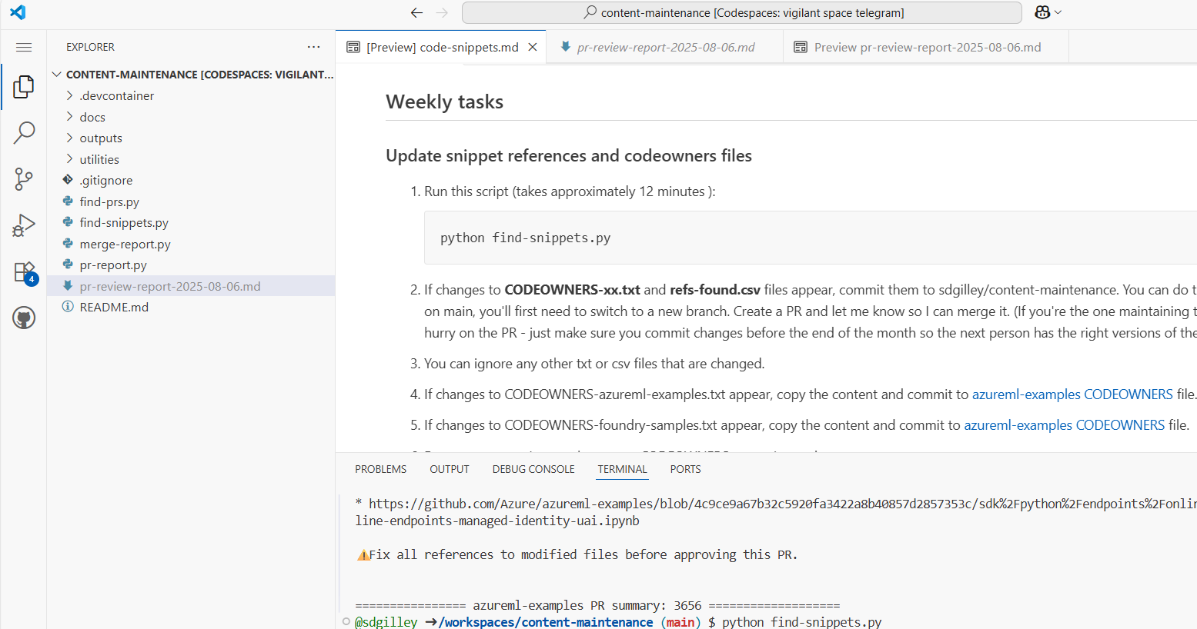
Search docs
Notes:
Now for the weekly tasks.
The first task is to search through the docs to find any changes in the files we reference.
This process builds codeowners files for each of the Code Repos we’re monitoring. It takes around 12 minutes to complete.
This process also builds a CSV file that other scripts use to lookup which docs article is referencing which code files.

Slide 16
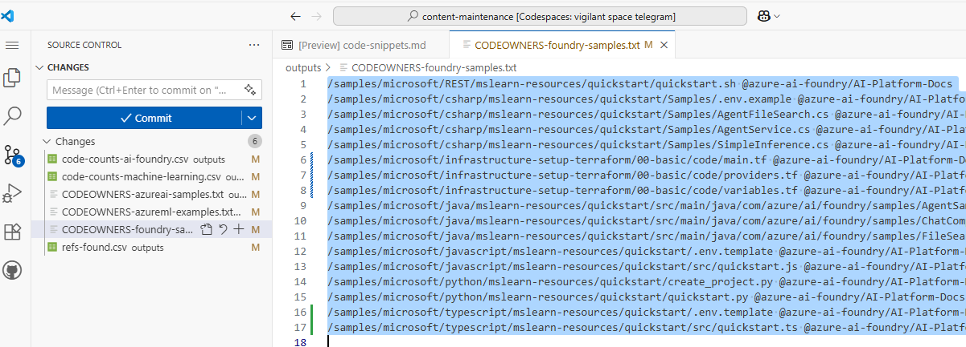
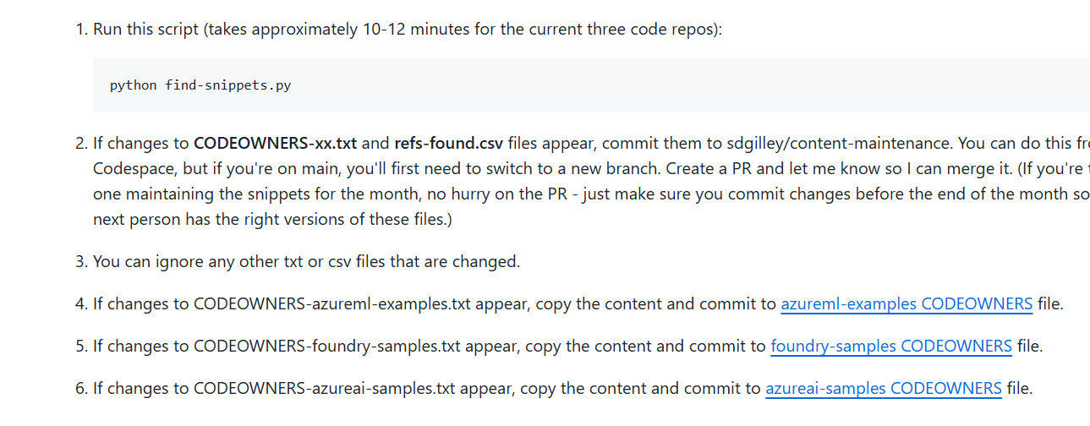
Update CODEOWNERS (Code Repo)
select all and copy
Notes:
Once the script runs, if there are changes in the codeowner files, open each one, copy the text, and go to the associated codeowner file using the link in the instructions.

Slide 17
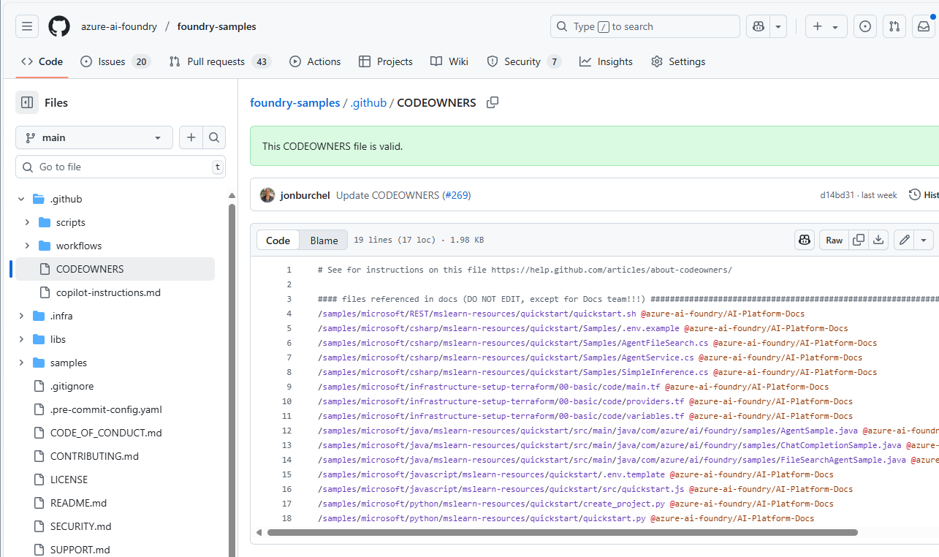
Update CODEOWNERS (Code Repo)
Notes:
Edit the codeowners file and replace the current files with what you just copied. Create a PR in the Code Repo to update this file.

Slide 18
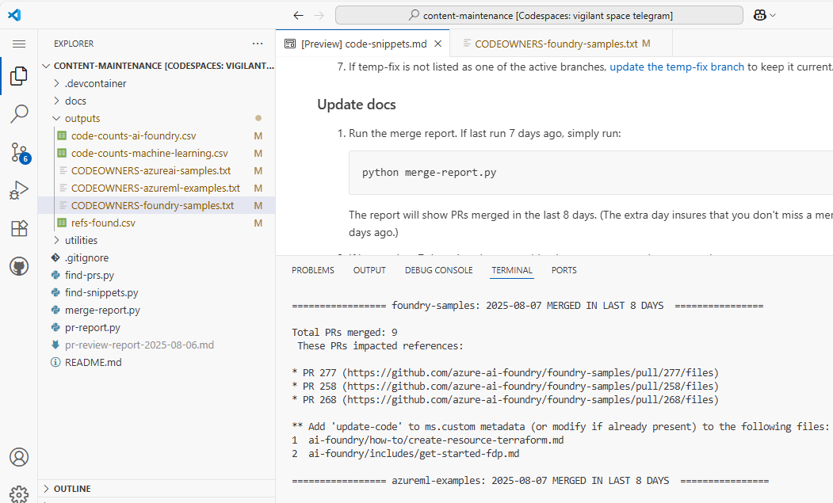
Update Docs (Docs Repo)
Notes:
The next thing to do on a weekly basis is find the documents that need to be rebuilt.
To do this, you run the merge-report. For each repo, it gives a list of the PRs that had changes to files referenced in our docs. We add or change the update-code custom metadata in our Docs Repo for all the listed files so that the files get rebuilt with the updated code.

Slide 19
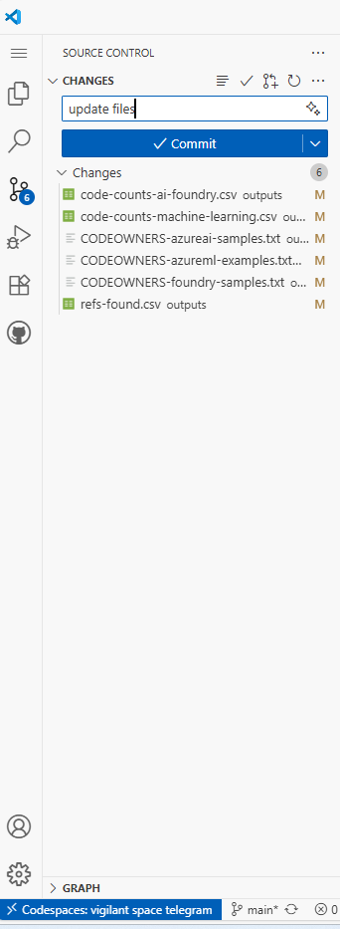
Update files (Maintenance Repo)
CODESPACE
Notes:
Finally, on a weekly basis, we update the files in the Maintenance Repo itself so that next week, or the next person using the repo, will have the most up to date files.

Slide 20
Maintenance Process Summary
Daily
Monitor pull requests in code repositories
Weekly
Update CODEOWNERS files
Update docs to rebuild
Update maintenance repo files
See github.com/sdgilley/content-maintenance
Notes:
That’s the process. This process allows us to prevent build breaks and keep documents up to date with the latest changes. It’s a win-win!

Slide 21

Questions?
Notes:
Reach out to Sheri Gilley if you have any questions.

Slide 22

Resources
sdgilley/content-maintenance
How to include code in articles on Microsoft Learn - Platform Manual | Microsoft Learn
Notes:
You can find the Maintenance repo at github.com/sdgilley/content-maintenance
You can find information about including code in articles in the Learn Platform Manual

